Slide 1
EscapeAI
By the escApIsts - Lee Gallagher & Nimrod Rankin

Slide 2
Overall Project & Theme
A point-and-click escape room game and adventure that is designed to both be an interesting game as well as an educational experience with a theme of AI & the future of computing.
Player is stuck in an AI/tech lab with a large locked door at the end of the room, a robot that can open that door, but which is very clearly broken, and a desk with a desktop PC and a 3D printer.
Player must solve 3 main puzzles to escape.

Slide 3
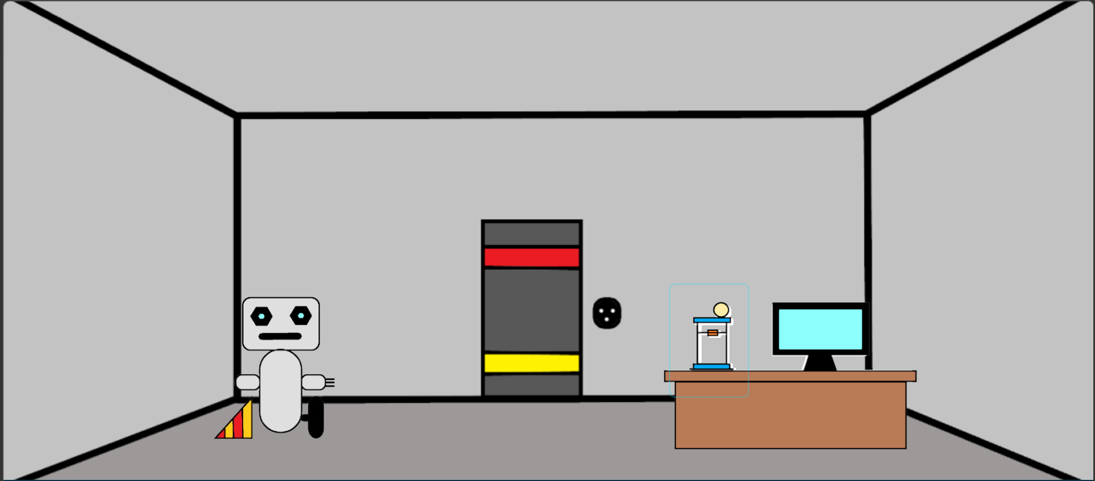
Overall Project & Theme

Slide 4
Puzzle 1 – 3D Printer
The player must solve the first puzzle by using a simple drag-and-drop interface to design and print a new wheel and wheel assembly for the broken robot.
The theme of this exercise is Computer-Aided Design (CAD) and the technology of 3D Printing.

Slide 5
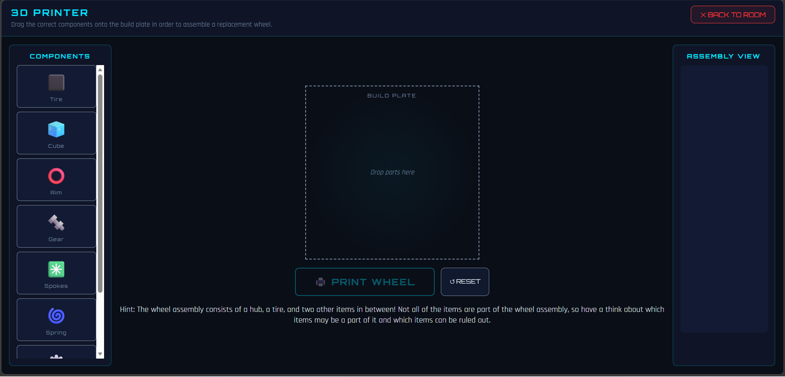
Puzzle 1 – 3D Printer

Slide 6
Puzzle 2 – Network Repair
After physically repairing the robot with the 3D printer and the new component, the player must then re-establish the wireless network connection between the PC and the robot.
Puzzle involves changing IP Address, Subnet Mask and Gateway to make sure the robot and the PC are on the same network, as well as a very basic wiring task.
This puzzle highlights the theme of networking.

Slide 7
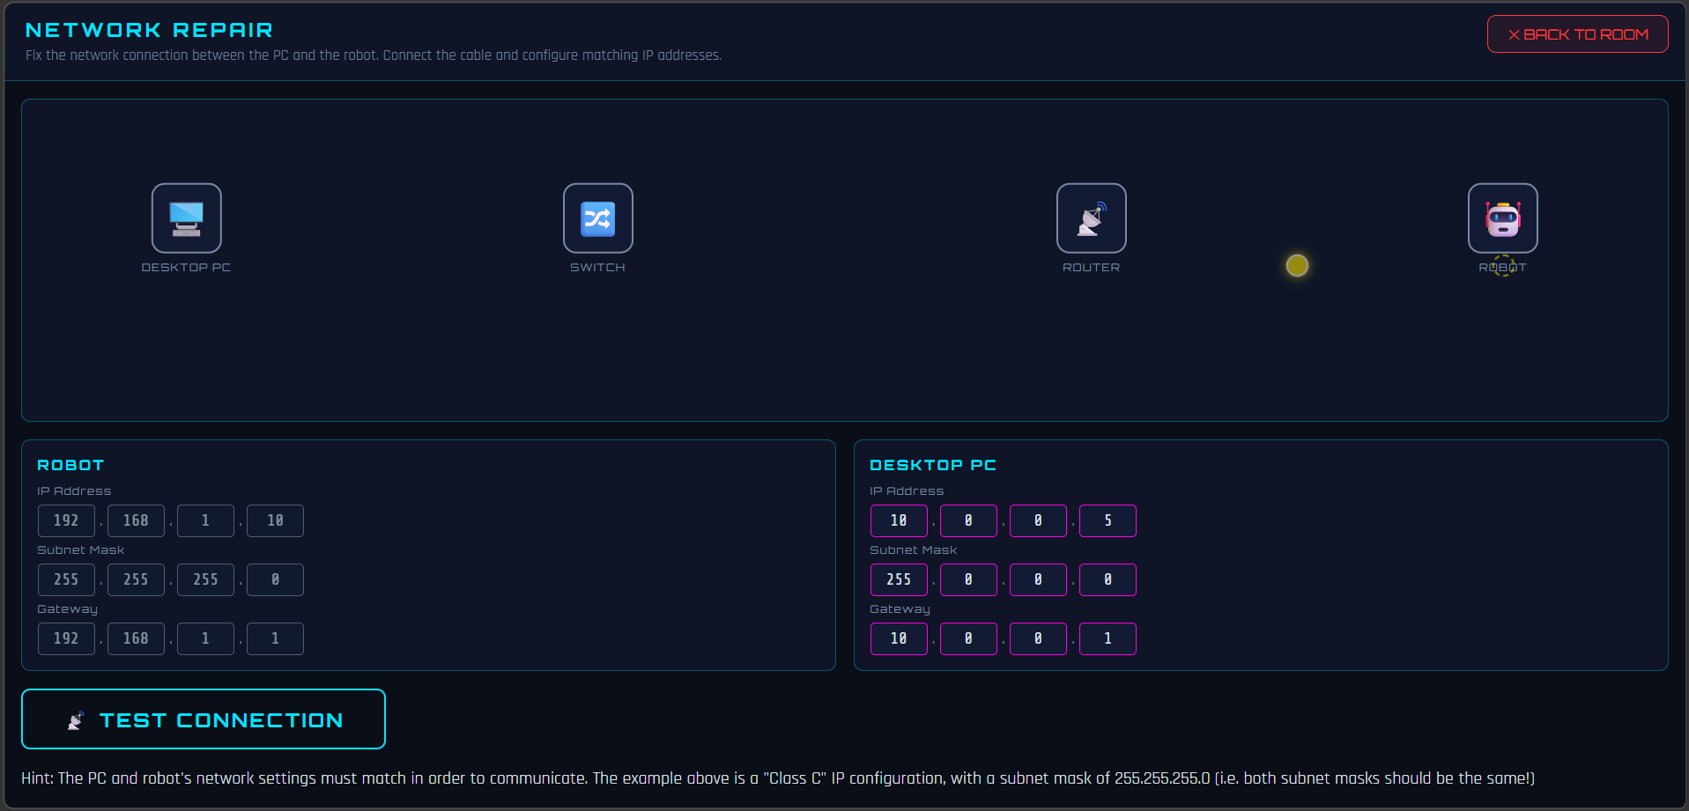
Puzzle 2 – Network Repair

Slide 8
Puzzle 3 – Coding Challenge
The robot's hardware & network connection is repaired, but the code that the robot is currently running is broken and stuck in a loop.
The player must use a simple drag-and-drop code editor to guide the robot to follow a path to the door, so that it can open it and thus the player may finally "escape".
This challenge educates the player in a very basic way about the fundamentals of programming and coding.

Slide 9
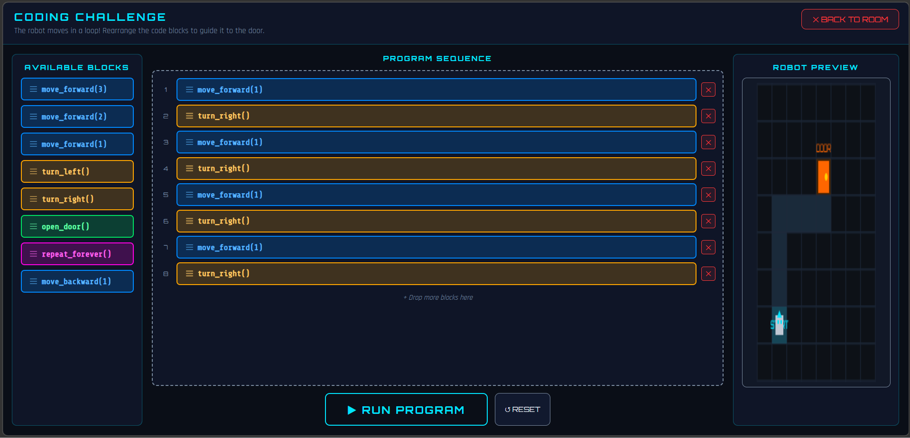
Puzzle 3 – Coding Challenge

